Slide 1
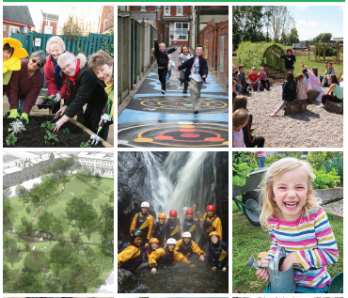
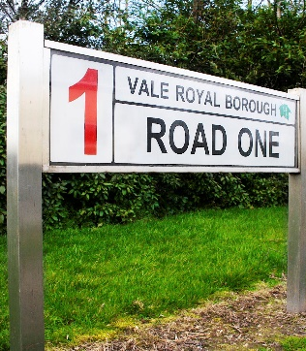
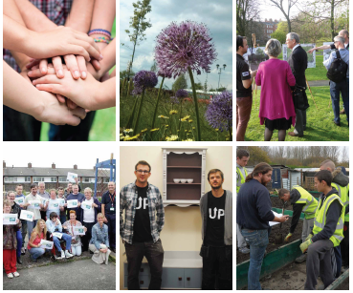
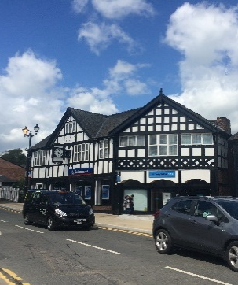
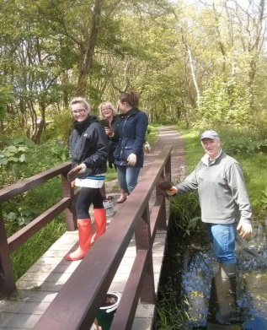
Groundwork
In Halton
October 2015

Slide 2
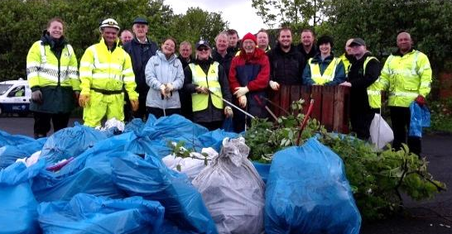
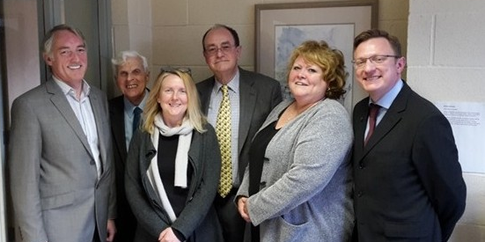
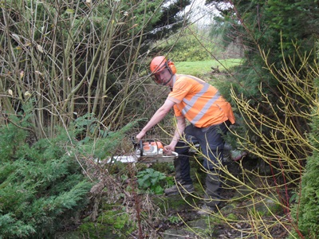
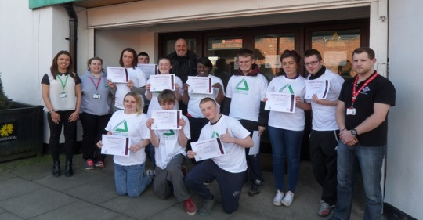
About us
We’ve been building more sustainable communities across Cheshire, Lancashire and Merseyside since 1983.
We help people and organisations to:
Create better neighbourhoods
Build skills and improve job prospects
Live and work in a greener way

Slide 3
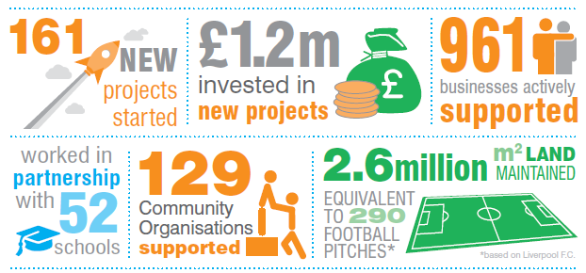
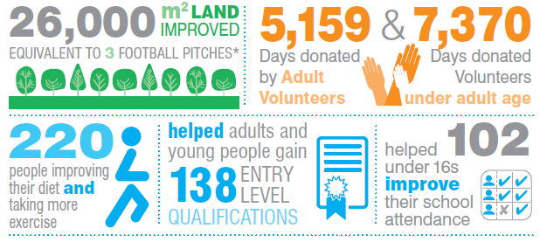
Notes:
And are we having an impact?
The man who used to live in the woods
The woman who hasn’t been out of her front door for years
Green space apprentice - given up legal highs and now has a family and a home
So the need is there – our ability to deliver is demonstrated - but is the money there. Can we deliver our charitable purpose in a financially sustainable way?

Slide 4
Capability
Landscape Design and Build
Business
Community
Employment and Skills
90+ staff working across 4 key hubs
Charity with £4million+ turnover

Slide 5
Key Partners / Funders
groundwork.org.uk/clm

Slide 6
Landscape Design & Build
Landscape Design Services
Landscape Build Team
Landscape Maintenance

Slide 7
Sustainable Communities
Improving Health & Well-Being
Connecting communities with Green Spaces
Developing Young People as Active Citizens
Tackling Fuel Poverty
Heritage Specialist Services

Slide 8
Sustainable Business
Business Engagement
Business Support and Training
Project Management and Implementation
Notes:
Business Improvement District (BID) Development
Business Development with Commercial Prospects
Business Diagnostics (Low Carbon, Resource Efficiency, Digital)
Business Consultancy (Env. Management, Standards, Carbon, Energy, Quality, Health & Safety)
Seminars and Training
Estate / Business Park and Town Centre Management, Events and Festivals
Landscape Enhancement,
Consultancy Support
Sustainable Transport

Slide 9
Employment & Skills
Team Based Personal Development
Information Advice & Guidance
Achievement Coaching
Pre-Employment Support
Alternative Education
Vocational Education

Slide 10
Employment & Skills
Vision To Inspire children, adults and families to achieve their full potential”.
Mission
To provide a supportive, enjoyable, disciplined and quality focused experience with Groundwork, through stimulating programmes that promote resilience and lifelong learning.
groundwork.org.uk/clm

Slide 11
Partnership…. www.groundwork.org.uk.clm
groundwork.org.uk/clm

