Slide 1
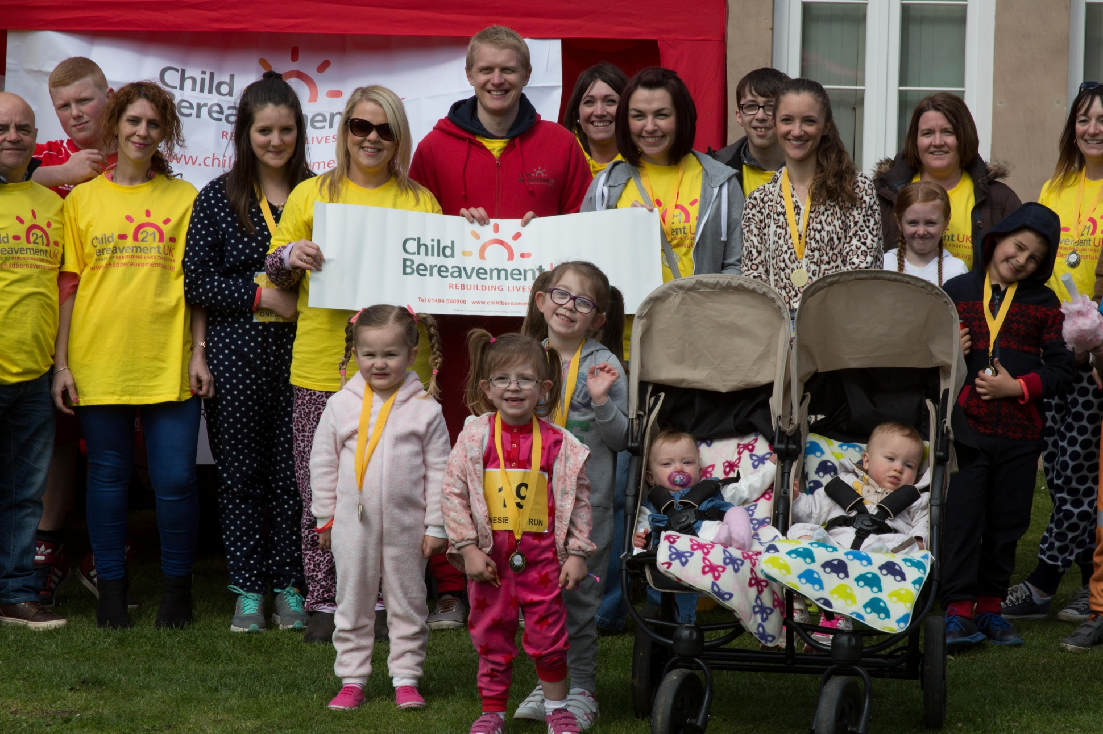
About our charity
Jonathan Evans
Fundraising and Communications Officer

Slide 2
Supports families when a baby or child of any age dies or is dying, or when a child is facing bereavement.
Trains professionals such as teachers and doctors, helping them to better understand and meet the needs of grieving families.
Notes:
This year is our 21st birthday as a national charity and we are continuing to grow, with more centres planned to open around the UK.

Slide 3
Why are we needed?
506,790 deaths in England in 2013
Every 22 minutes in the UK a parent of dependent children dies (approx 23,600 a year) leaving about 41,000 bereaved children. 111 newly bereaved children every day.
http://childhoodbereavementnetwork.org.uk/research/key-statistics.aspx
Notes:
CBN
Rich

Slide 4
Why are we needed?
Many more are bereaved of a grandparent, sibling, school friend or other significant person.
78% 11-16 year olds reported the death of a first or second degree relative or close friend
Notes:
CBN
Rich

Slide 5
Unresolved grief issues
Result in higher incidences of:
Academic under-achievement
Challenging behaviour/ mental health issues
Teenage parents
Youth Offenders
Suicides
www.cbn@ncb.org.uk
Notes:
Abdelnoor and Hollins’ research. CBN collated range of research.

Slide 6
Cost-saving potential of bereavement support
Society
Education
Social Work
Mental and Physical Health
Justice system
Notes:
There is a powerful case for the cost-saving potential of bereavement support.

Slide 7
Why are we in Halton?
We opened a centre in Runcorn in March 2014 after extensive research found a need for this service in the borough.
Our aim is for everyone in the region to have access to high quality bereavement support if they need it.
We also want professionals to have the right training to support people with bereavements.

Slide 8
What have we achieved in the past 18 months?
We have provided free bereavement support to 113 families and a total of 139 children.
We have delivered bereavement awareness and other training to 233 people.

Slide 9
What have we achieved in the past 18 months?
We have set up bereavement support groups for children aged 5 to 12.
We hold young people’s advisory groups for young people aged 11 to 25.
We have held community fundraising events including a Snowdrop Walk, Onesie Fun Run and Dash for Dad family day.

Slide 11
How de know we are helping people?
Evie, from Widnes, whose dad died, has been coming to CHYPS and having one to one sessions since October 2014.
Mum Linzi said: “Working one to one has helped Evie get some of her confidence back. She is learning to talk instead of bottling things up. CHYPS opened her eyes to the fact she’s not the only child in the world to lose her dad.”
Evie, aged 9, said: “Coming along has helped me worry a lot less. I always feel happier afterwards.”
Notes:
What’s really important for us is not just the figures, but knowing that our service is having a positive impact on people’s lives. So what I’ve done since coming in to post in March is speaking to a number of our service users. This firstly lets us know we are doing a good job but also helps when it comes to funding applications. One of the main things we’ve learnet is that we are giving bereaved youngsters their confidence back and helping them open up and talk about their feelings.

Slide 12
How do we know we are helping people?
“Being part of the Young People’s Advisory Group has made me understand that other people are going through the same thing as me. It has also helped my confidence.”
– Ben,15, from Warrington.
“Coming along to the charity has helped me a lot. It has given me confidence to talk about my feelings and I’ve been able to meet people in a similar situation.”
– Alisha, 15, from Widnes.

Slide 13
What our volunteers say...
“I came along to last year’s Dash for Dad Fun Run and it all started from there. What I was most impressed with was the commitment and passion of the team who help those people in need of guidance, and who support children and families on their long journey ahead. The work the charity is doing in the local area is amazing and it’s a great cause to raise money for.”
- Steve Jones, from Runcorn

Slide 14
But this is just the tip of the iceberg...
How many people are suffering in silence across the borough?
1 in 29 pupils have been bereaved of a parent or sibling - that's a child in every class.
But 80% of teachers have no training in how to deal with a bereaved pupil.

Slide 15
And we need the help of the community...
It costs £26 to answer and deal with a call to our support and information line.
It costs on average £1,000 to give face to face support to a family.
The service is free, so we survive solely on donations and grants and do not receive any public funding.

Slide 16
Thank you Any questions?

Slide 17
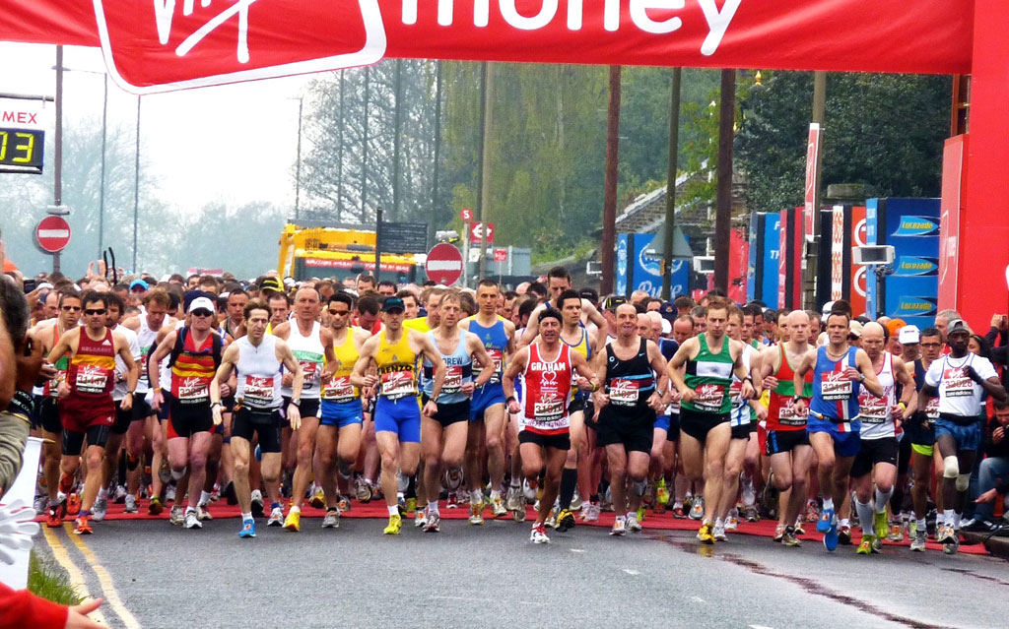
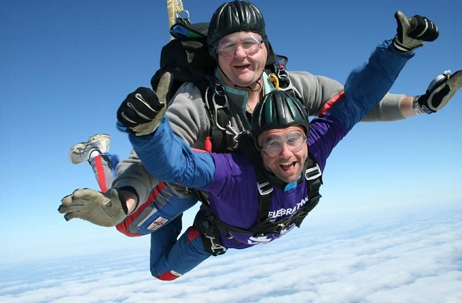
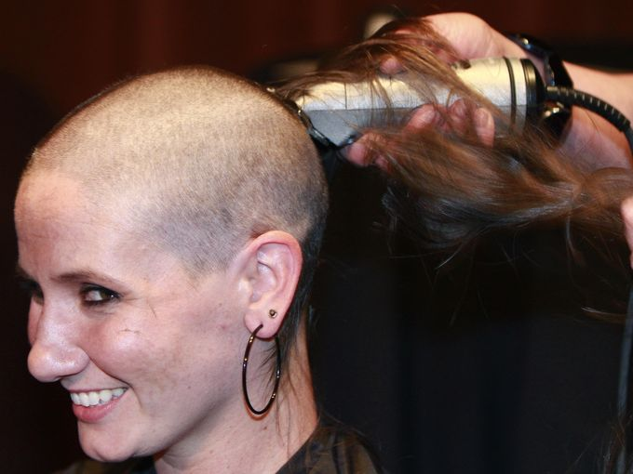
Fundraising
Notes:
We rely on people’s good will and a lot of this is through fundraising events.
You can do literally anything from a cake sale to a sky dive and everything in between.
Anyone interested can let me know.

Slide 18
Volunteering
Notes:
This could be at our events (like this picture at our onesie fun run)
We also have opportunities for people who want to come into the office and help with admin tasks.
And there are opportunities to help support bereaved pupils at our group sessions, for which training is provided.

Slide 19
Rotary club support
Notes:
It could be that you want to make a one off donation, or make us your charity of the year?
Any support is greatly appreciated

Slide 20
Thank you!
Any questions?

